Slide 1



GREENOVATEX
Group Project
CEO: Aditya Singh
1

Slide 2




Our Team
Research & Development
Marketing Analysis
Technical Team
Environment Team
Shubham Agrawal
Piyush Shah
Priyanshu Choudhary
Sunny Kumar
Navdeep
Shubhi Verma
Sanjeeta Singh
Aman Singh
Neeraj Kajala
Sunny Kumar
Sumit Chouhan
Divyansh Gupta
2

Slide 3

OVERVIEW
RnD team patented chemicals :
Malathion
Sodium Lauroamphoacetate
Hydroxypropyl Methylcellulose
Chosen Chemical for further analysis:
Malathion, patented by Navdeep and Sodium Lauroamphoacetate patented by Shubham
Work Done by different department include:
Finding Chemical Synthesis route, market availability, economic feasibility, uses and eco-friendliness.
3

Slide 4

MALATHION
Organophosphate insecticide widely used in agriculture, public health, and residential pest control
Broad-spectrum insecticide with quick knockdown effect.
Low cost and economically viable for large-scale applications.
Relatively low toxicity to humans and mammals when used correctly.
Biodegradable — breaks down quickly in the environment.
LOGISTICS:
Total Value of Imports in India: $ 103,839 • Average Price per Unit: $2.31(CHINA)
Total output per day = 1000 kg Malathion +104.5 kg of by-products and 30 kg of waste for recycling
Not so harmful waste, just eye irritant, flammable having TWA, STEL limit is 1-5ppm, while some have upto 250mg/m^3.
4

Slide 5

SODIUM LAUROAMPHOACETATE
mild amphoteric surfactant, derived from coconut oil. It is widely used in personal care and cleansing products due to its gentle action, excellent foaming ability, and compatibility with other ingredients.
Biodegradable and environmentally friendly.
Per-kg production cost: Slightly higher than SLS or ALS
But offset by higher retail pricing and greater consumer willingness to pay for gentle, natural-sounding ingredients.
LOGISTICS:
Total Value: $156,396 Average Price per Unit: $2.68 (THAILAND(major), CHINA)
Production : 1102.3 Kg/day ,
Quite safe to produce, waste causes skin irritation, some cause serious damage to skin,
TWA and STEL data ranges between 0.1 ppm to 4 ppm
5

Slide 6
Research and Development
SHUBHAM AGARWAL
NAVDEEP
NEERAJ KAJALA
6

Slide 7
Research and Development
Sodium Lauroamphoacetate
Overview
Sodium lauroamphoacetate is a zwitterionic surfactant .It is an speciality chemical due to its unique charecterstics of foaming and mildness. Its mildness and multifunctionality make it a key ingredient in both cosmetic and industrial applications.
- Molecular Formula:C18H35N2NaO4
- Molecular Weight: 349.46 g/mol
-Physical appearance: Pale yellow liquid
- Used in shampoos, body washes, facial cleansers, and baby products as a gentle cleaning agent.
-Biodegredable and environment safe.
7

Slide 8

Amidification process for Sodium Lauroamphoacetate
STEP 1 Amidation Reaction:
Formation of Amidoamine Intermediate
REACTION:
Fatty Acid+Aminoethylethanolamie =>Amidoamine Intermediate +Water
REACTION CONDITIONS:
TEMPERATURE= 150-180 degree celcius
PRESSURE: 10-50 mbar
REACTOR USED: BATCH OR CSTR
A Vaccum system is used to remove excess water.
STEP 2 Carboxymethylation Reaction:
Formation of Alkyl Amphoacetate
REACTION:
Amidoamine Intermediate + Sodium Monochloroacetate => Alkyl Amphoacetate surfactatnt + NaCl
REACTION CONDITIONS:
TEMPERATURE= 80-100 degree celcius
Ph= 9-10 It is maintained by constant addition of NaOH
Controlled Addition of SMCA / Cyanide + Formaldehyde to prevent side reactions.
8

Slide 9
Alternate process using Formldehyde and Cyanide
STEP 1 Amidation Reaction:
Formation of Amidoamine Intermediate
REACTION:
Fatty Acid+Aminoethylethanolamie =>Amidoamine Intermediate +Water
REACTION CONDITIONS:
TEMPERATURE= 150-180 degree celcius
PRESSURE: 10-50 mbar
REACTOR USED: BATCH OR CSTR
A Vaccum system is used to remove excess water.
STEP 2 Carboxymethylation Reaction:
Formation of Alkyl Amphoacetate
REACTION:
Amidoamine Intermediate + Formaldehyde+Sodium Cyanide => Alkyl Amphoacetate surfactatnt + NaCl
REACTION CONDITIONS:
TEMPERATURE= 80-100 degree celcius
Ph= 9-10 It is maintained by constant addition of NaOH
Controlled Addition of SMCA / Cyanide + Formaldehyde to prevent side reactions.
9

Slide 10
Reasons for using Process with SMCA
Overall yield of Sodium Lauroamphacetate is greater when we used Cyanide and Formaldehyde but we prefer SMCA due to envoirmental and safety reasoms.
We choose to work with SMCA over Cyanide and Formalydehyde because these are Toxic chemicals and are very difficult to handle.
Side reactions (cyanohydrin formation) can lead to impurities, reducing final product purity and increasing purification steps.
Although NaCN + Formaldehyde are cheaper than SMCA, the additional costs of safety systems, waste treatment, and regulatory compliance make the overall process expensive.
NaCN requires special airtight pipes and equipment. It has an increased risk of leakage.
10

Slide 11
Research and Development
Hydroxypropyl Methylcellulose
Overview
Hydroxypropyl Methylcellulose (HPMC) is a non-ionic cellulose ether derived from plant fiber, valued for its thickening, film-forming, and stabilizing properties. Non-toxic and biocompatible, it is widely used in pharmaceuticals, cosmetics, food, and industrial applications.
Molecular Formula: C56H108O30
Molecular Weight: Approximately 1241.42 g/mol (based on average substitution and polymer size)
Physical Appearance: White to off-white, odorless powder or granules
Applications:
In pharmaceuticals, used as a tablet binder, controlled-release agent, and film-coating material.
In cosmetics, acts as a thickener and stabilizer in creams, lotions, and eye products.
In the food industry, functions as a stabilizer, thickener, and emulsifier (recognized as E464).
Biodegradable and Environmentally Safe: Derived from renewable cellulose sources, HPMC is non-toxic, biodegradable, and considered environmentally friendly.
11

Slide 12
Prepration of HPMC by Alkylation and Etherification of Cellulose
STEP 1 : Alkylation of Cellulose with Sodium Hydroxide
REACTION:
Cellulose-OH + NaOH → Cellulose-O-Na + H2O
REACTION CONDITIONS:
Temperature: 30-50°C
Pressure: Atmospheric
Reaction Time: 1-2 hours
Catalyst: Excess NaOH (~5-10% excess)
Reactor used : Stirred Tank Reactor
Step 2: Etherification with Methyl Chloride
REACTION:
Cellulose-O-Na + CH3Cl → Cellulose-CH3 + NaCl
REACTION CONDITIONS:
Temperature: 50-70°C Pressure: Slight pressure (1-2 atm)
12

Slide 13
Step 3: Etherification with Propylene Oxide
REACTION:
Cellulose-O-Na + C3H6O → Cellulose-O-CH2CH(OH)CH3 + NaOH
REACTION CONDITIONS:
Temperature: 60-80°C
Pressure: Slight pressure (1-2 atm)
Reaction Time: 3-5 hours
Catalyst: Propylene Oxide (C3H6O)
Step 4: Neutralization and Washing
REACTION:
Cellulose-O-CH2CH(OH)CH3 +CH3COOH → Cellulose-O-CH2CH(OH)CH3 + CH3COONa
REACTION CONDITIONS:
Temperature: 25-40°C
Reaction Time: 1-2 hours
pH: Adjusted to 6-7 using acetic acid.
13

Slide 14
Alternate process using Sodium Cyanide
STEP 1 : Alkylation of Cellulose with Sodium Hydroxide
REACTION:
Cellulose-OH + NaOH → Cellulose-O-Na + H2O
REACTION CONDITIONS:
Temperature: 30-50°C
Pressure: Atmospheric
Reaction Time: 1-2 hours
Catalyst: Excess NaOH (~5-10% excess)
Reactor used : Stirred Tank Reactor
Step 2: Etherification with Methyl Chloride and Sodium Cyanide
REACTION:
Cellulose-O-Na + CH3Cl + HCHO + NaCN → Cellulose-O-CH2CH(OH)CH3 + NaCl
REACTION CONDITIONS:
Temperature: 60-80°C Pressure: Slight pressure (1-2 atm)
Reaction Time: 3-6 hours
Catalyst: Sodium Cyanide (NaCN) and Formaldehyde (HCHO)
14

Slide 15
Step 3: Etherification with Propylene Oxide
REACTION:
Cellulose-O-Na + C3H6O → Cellulose-O-CH2CH(OH)CH3 + NaOH
REACTION CONDITIONS:
Temperature: 60-80°C
Pressure: Slight pressure (1-2 atm)
Reaction Time: 3-5 hours
Catalyst: Propylene Oxide (C3H6O)
Comparision between two methods:
Alkylation and Etherification Method: Higher yield (~95-98%)
Requires two separate reactors for alkylation and etherification.
Longer reaction time (5-10 hours).
More control over the degree of substitution.
Direct Etherification Method: Simpler process with a single reactor.
Shorter reaction time (4-8 hours).
Lower yield (~90-93%).
Less control over the degree of substitution.
15

Slide 16
Reasons Why the Sodium Cyanide Route is Not Preferred
Highly Toxic:
Sodium cyanide is extremely poisonous, posing severe health risks through inhalation, ingestion, or skin contact.
Environmental Hazards:
Accidental release can cause serious contamination to soil and water bodies, affecting ecosystems.
Strict Regulatory Controls:
Due to its toxicity, its use, transport, and disposal are heavily regulated, increasing compliance costs.
Risk of Cyanide Poisoning:
Even small mishandling can lead to fatal exposure for workers, requiring specialized training and protective equipment.
Safer Alternatives Available:
Modern synthesis routes now favor greener and safer reagents, reducing reliance on hazardous chemicals like cyanide.
16

Slide 17

Research and Development
MALATHION
Overview
Malathion is an organophosphate insecticide used for pest control in agriculture, public health, and residential settings. It inhibits cholinesterase in insects, leading to paralysis and death. When used as directed, it has low toxicity to humans and degrades quickly in the environment.
Molecular Formula: C₁₀H₁₉O₆PS₂
Molecular Weight: ~330.35 g/mol
Physical Appearance: Pale yellow to brown liquid with a faint odor
Applications:
In agriculture, controls pests on fruits, vegetables, and grains.
In public health, used in mosquito control programs.
In residential use, treats lice and garden pests.
17

Slide 18
Direct Esterification of O,O-Dimethyl Phosphorodithioic Acid
CHEMICAL REACTION
O,O-Dimethyl Phosphorodithioic Acid+Diethyl Maleate→Malathion+H2O
Reactants:
O,O-Dimethyl Phosphorodithioic Acid (DMPA) → (CH₃O)₂PS₂H
Diethyl Maleate (DEM) → C₆H₁₀O₄
Products:
Malathion → C₁₀H₁₉O₆PS₂
Water (byproduct)
Catalysts/Additives:
Sulfuric Acid (H₂SO₄) or p-Toluenesulfonic Acid (p-TSA) as an acid catalyst.
Sodium Hydroxide (NaOH) for neutralization.
18

Slide 19
REACTION CONDITIONS:
Temperature : 80-100°C
Pressure : Atmospheric or slight vacuum
Catalyst : Sulfuric Acid (H₂SO₄) / p-TSA
Reaction Time : 2-4 hours
pH Control : NaOH neutralization (pH 7-8)
19

Slide 20

Malathion Production via Thiophosphorylation of Diethyl Fumarate/Diethyl Maleate
CHEMICAL REACTION
1.Synthesis of O,O-Dimethyl Dithiophosphoric Acid:
P2S5 + 4CH3OH → 2(CH3O)2P(S)SH + H2S
2.Thiophosphorylation Reaction (Formation of Malathion): (C2H5O2C)CH=CH(COOC2H5) + (CH3O)2PS2H
→ Malathion + Byproducts
20

Slide 21
REACTION CONDITIONS:
·Synthesis of O,O-Dimethyl Dithiophosphoric Acid:
Temperature: 50-60°C.
Reaction Time: 1-2 hours.
Pressure: Atmospheric.
Stirring: Continuous.
·Thiophosphorylation Reaction:
Temperature: 50-80°C.
Pressure: Atmospheric or slight vacuum.
Reaction Time: 3-6 hours.
Catalyst (if used): Acidic (H₂SO₄) or Basic (NaOH).
21

Slide 22
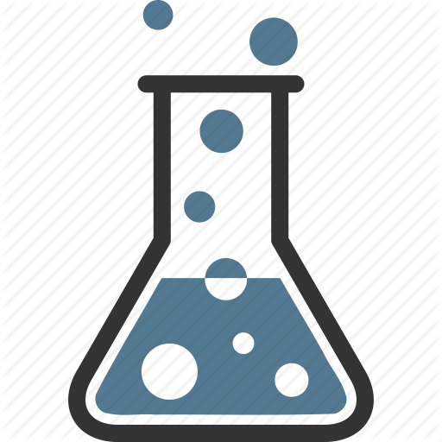
Reasons Why Direct Esterification of O,O-Dimethyl Phosphorodithioic Acid Preferred
·Direct Esterification of O,O-Dimethyl Phosphorodithioic Acid gives higher yield (~98%) and is more efficient.
·Thiophosphorylation of Diethyl Fumarate is safer as it avoids POCl₃ and NaCN.
·Direct Esterification has faster reaction time and simpler purification steps.
·Thiophosphorylation operates under milder conditions (50-80°C) but has lower yield (~92-95%).
·Direct Esterification requires strict anhydrous conditions, as reactants are moisture-sensitive.
·Thiophosphorylation involves more reaction steps, leading to higher operational costs.
·Direct Esterification is preferred for industrial production due to better efficiency and cost-effectiveness.
·Thiophosphorylation is a viable alternative when safety and environmental factors are a priority.
22

Slide 23



Market Analysis
Malathion
Sodium Lauroamphoacetate
23

Slide 24
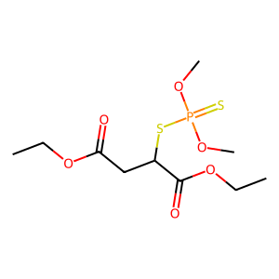
Malathion
Introduction
Chemical: Malathion (C₁₀H₁₅O₆PS₂ )
A versatile insecticide for crops, disease control, and household pests.
Primary use
Agriculture: Protects crops (fruits, cotton, rice) from pests.
Public Health: Mosquito control (malaria/dengue prevention).
Household: Insect sprays, pet treatments.
Medical: Lice/scabies lotions.
Why Malathion?
Superiority: Broad-spectrum, cost-effective, low toxicity, eco-friendly degradation.
Alternatives: Pyrethroids (e.g., Permethrin), Neonicotinoids (e.g., Imidacloprid).
24

Slide 25

Import Data and Production Economics
Import Trends in India
93.43% imports from China (total value: $329,729, average price: $4.83/unit).
Example: 10 mg analytical standard imported from USA at $28.74/unit.
Raw Materials and Costs
Diethyl Maleate (DEM): $38.82/unit (50% sourced from USA).
Phosphorus Pentasulfide (P₂S₅): $1.59/unit (mainly from China).
DMPA: $2.31/unit (China-dependent supply chain).
Key Feasibility Factors
Supply Risks: Reliance on China/USA for raw materials.
Profit Margins: Final product pricing must offset DEM/DMPA costs.
25

Slide 26
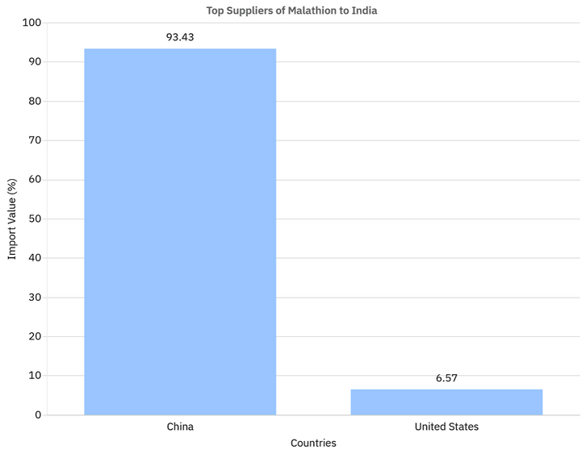
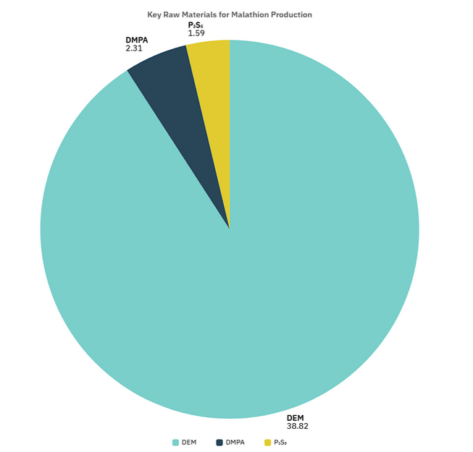
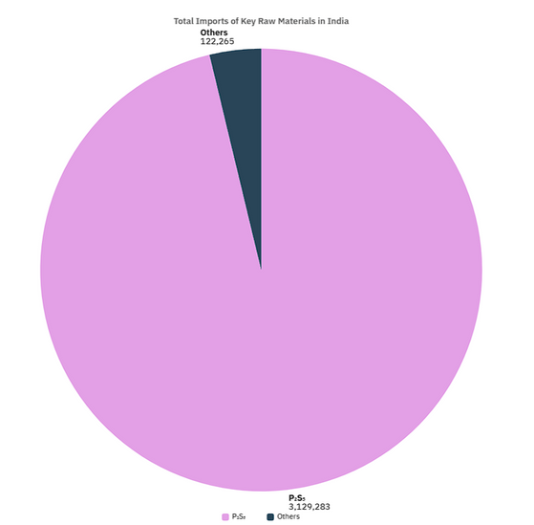
China dominates imports, supplying 93.43% of India’s Malathion.
DEM is the most expensive input.
P₂S₅ is cost-effective but China-dependent.
P₂S₅ has the highest import volume, critical for thiophosphorylation.
26

Slide 27
Strategic Takeaways
Market potential
High demand in agriculture/public health sectors justifies production.
Challenges
Import dependency (China) for raw materials, geopolitical risks.
Recommendations
Diversify Suppliers: Explore local/DEM alternatives (e.g., Germany).
Cost Optimization: Bulk procurement of P₂S₅/DMPA to reduce expenses.
Premium Pricing: Leverage Malathion’s efficacy for competitive pricing.
27

Slide 28
Sodium Lauroamphoacetate
Introduction
Chemical: Sodium Lauroamphoacetate (C18H38N2NaO3 )
Sodium Lauroamphoacetate is a mild, amphoteric surfactant derived from coconut oil, commonly used in personal care and household products. It offers gentle cleansing, excellent foam stability, and is ideal for sensitive skin formulations.
Primary use
Used in baby shampoos, facial cleansers, and body washes for gentle, non-irritating cleansing.
Enhances foam and conditioning in shampoos, shaving creams, and bath products.
Acts as a mild surfactant in household cleaners and textile processing.
Why Sodium Lauroamphoacetate ?
Exceptionally mild and non-irritating, making it ideal for sensitive skin and baby care products.
Balances foam and cleansing better than alternatives like SCI or Decyl Glucoside, without causing dryness.
Highly compatible with other surfactants and is eco-friendly, aligning with clean beauty and sustainable trends.
28

Slide 29
Import Data and Production Economics
Import Trends in India
9.73% imports from Thailand (total value: $155,977 out of $156,396 total; average price: $2.68/unit)
Minor import from China (value: $419)
Major port of entry: Nhava Sheva Port (Jawaharlal Nehru Port, Maharashtra)
Other entry point: Delhi Air Cargo (for small volume imports)
Raw Materials and Costs
AEEA (Aminoethyl Ethanolamine)
Imported mainly from Sweden at $2.59/unit; high-cost critical input.
Enters India via Nhava Sheva Port; used for forming the surfactant structure.
Lauric Acid
Sourced from Malaysia and Indonesia at $1.18/unit; moderately priced.
Widely used in cosmetics and detergents; major ports include Nhava Sheva and Chennai.
Key Feasibility Factors
Supply Risks:
Heavy reliance on Sweden for AEEA import poses a single-source risk.
Global shipping issues or policy changes can affect Lauric Acid supply from Malaysia/Indonesia.
Profit Margins:
High cost of AEEA ($2.59/unit) must be offset by premium pricing of final product.
Profitability depends on efficient bulk procurement and demand for mild, eco-friendly surfactants.
29

Slide 30
Strategic Takeaways
Market potential
Sodium Lauroamphoacetate has strong market potential due to rising demand for sulfate-free, gentle surfactants in baby care, skincare, and premium shampoos. Its biodegradable, eco-friendly nature aligns perfectly with the global shift toward clean beauty and sustainable formulations, especially in growing markets like Asia-Pacific.
Challenges
India faces challenges due to reliance on imported raw materials like AEEA, mainly from Sweden, increasing vulnerability to global price shifts. Limited domestic production capacity and dependency on ports like Nhava Sheva can impact supply stability and lead times.
Recommendations
To reduce supply risks, India should diversify import sources and invest in domestic production of key raw materials like AEEA. Encouraging R&D in green surfactants and forming strategic partnerships can enhance cost-efficiency and market competitiveness.
30

Slide 31
Technical Services
Sumit Chouhan
Sanjeeta Singh
Priyanshu Kumar Chaudhary
31

Slide 32
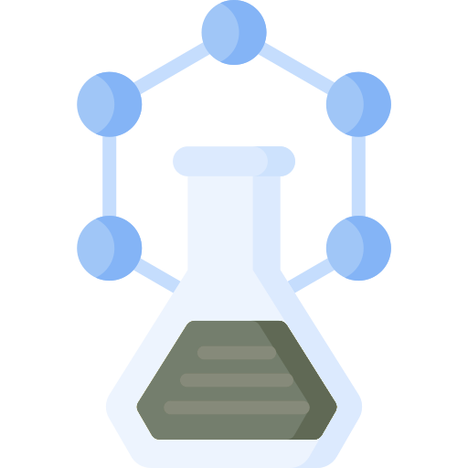
Malathion Production
Overview
Here we focus on industrial-scale production of Malathion (chemical formula: C₁₀H₁₉O₆PS₂) through a direct esterification process.
Malathion is a widely used insecticide, and the project aims to design a full plant setup, material balance, economic analysis, and equipment requirement for its efficient and profitable manufacturing.
32

Slide 33
Chemicals Required
Main reactants:
O,O-Dimethyl Phosphorodithioic Acid (DMDTPA)
Diethyl Maleate (DEM)
Sodium Hydroxide (NaOH) for pH adjustment
Catalysts and Others:
Sulfuric Acid / p-Toluenesulfonic Acid
33

Slide 34
Vessels Required:
Esterification Reactor (Glass-Lined or Stainless-Steel Reactor with Acid Resistance)
Mixing Vessel
Separation Vessel (Decanter/Settler)
Filtration Unit (Vacuum Filter or Pressure Filter)
Distillation Column (Fractional Distillation Unit)
Product Storage Tank (HDPE or Stainless Steel with Antioxidant Lining)
Solvent Storage Tank
Waste Neutralization Tank
34

Slide 35
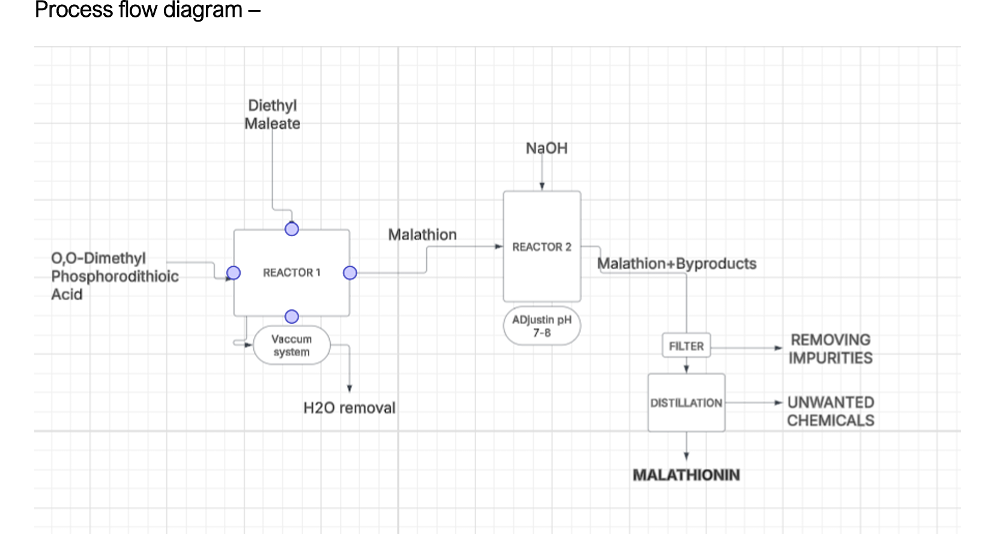
35

Slide 36
Reaction Involved
Esterification:
C8H12O4+(CH3O)2PS2H→C10H19O6PS2+H2O
Adjustment of pH & Neutralization (Side Reaction):
H3PO4+NaOH→NaH2PO4+H2O
36

Slide 37
Material Balance (Daily Basis for 1000 kg Malathion Production)
Material
Diethyl Maleate (DEM)
DMDTPA
NaOH (for pH control)
Water (by-product removed)
Daily Requirement (kg)
512.2
533.3
50
54.5
37

Slide 38

Economic Analysis
Cost Heads | Amount (₹)
Total Raw Material Cost | ₹4,21,622
Total Utilities Cost (Electricity, Steam, Water, Waste Disposal) | ₹33,960
Total Daily Production Cost | ₹4,55,582
Cost per kg of Malathion | ₹455.58
38

Slide 39
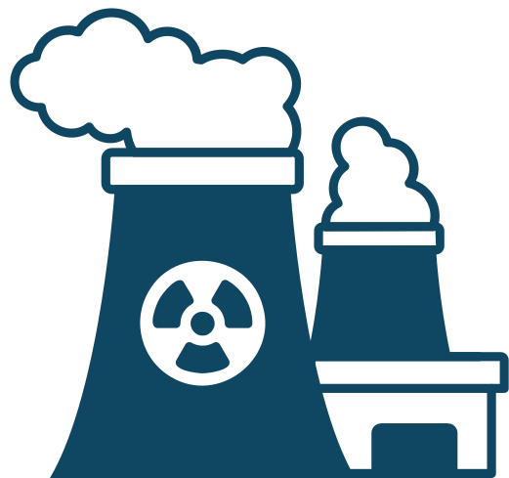
CAPITAL COST
Reactors (each 1500 L capacity)
Cost per Reactor: ₹83.93 lakh (2014 basis)
Two reactors needed: One for esterification, one for pH adjustment.
This process design ensures high-efficiency production of Malathion with minimal waste.
Profit margins are substantial, with daily profits nearing ₹9.6 lakh for 1000 kg production.
Process is scalable, sustainable, and economically viable for industrial applications.
39

Slide 40

Technical Services
Sodium Lauroamphoacetate
Overview
Process Title:-
Production of Sodium Lauroamphoacetate from Lauric Acid
Raw Materials Required:-
Lauric Acid
Sodium Chloroacetate
Ammonia
Coconut Oil
Water
pH Adjusters
Data Provided:-
Total feed: 1000 kg/day
Reaction yield: 90%
Equipment Required:-
Amidation Reactor (Glass-Lined CS, R-101)
Carboxymethylation Reactor (Glass-Lined CS, R-102)
40

Slide 41
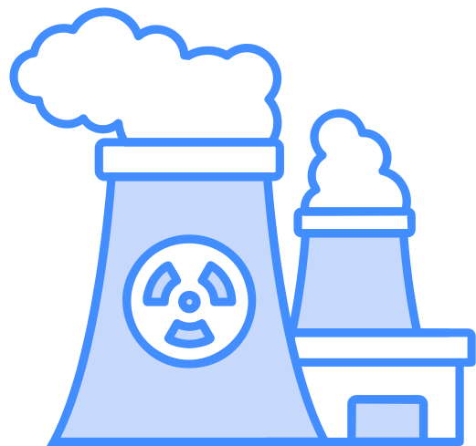
Mass Flow Rate Calculation for Sodium Lauroamphoacetate
STEP 1 Amidation Reaction:
Lauric Acid + AEEA → Amidoamine + H₂O
Lauric Acid in feed: 60% of 1000 kg = 600 kg/day:
Moles of Lauric Acid: 600,000g ÷ 200.32 g/mol = 2,995 moles
Since reaction is 1:1, AEEA required = 2995 mol
Mass of AEEA(Aminoethylethanolamine):
2,995 moles × 104.15 g/mol = 311.85 kg/day
Mass of Amideamine Intermediate Produced:
2,995 moles × 286.7 g/mol = 857.9 kg/day
STEP 2 Carboxymethylation Reaction:
Amidoamine + Sodium Monochloroacetate → Sodium Lauroamphoacetate + NaCl
Reaction again is 1:1, Mass of SMCA =348.84 kg/day
Sodium Lauroamphoacetate: = 1,103.2 kg/day
NaCl byproduct: = 175 kg/day
41

Slide 42
Cost Calculation
STEP 1
Total mass per batch ≈ 912 kg
Density: ~900 kg/m³
Volume calculation: 912 kg ÷ 900 kg/m³ = 1.01 m³
With 70% fill factor: 1.01 m³ ÷ 0.7 = 1.44 m³
Selected reactor size: 1.5 m³ Glass-Lined CS Reactor
STEP 2
Total input mass ≈ 1,206.7 kg
Density: ~ 930 kg/m³
Volume calculation: 1,206.7 kg ÷ 950 kg/m³ = 1.27 m³
With 70% fill factor: 1.27 m³ ÷ 0.7 = 1.81 m³
Selected reactor size: 2 m³ Glass-Lined CS Reactor
Equipment | Design Capacity (L) | No. of units | Cost/unit ( for year 2014)
Amidation Reactor (Glass-Lined CS, R-101) | 1500 | 1 | ₹24,97,500
Carboxymethylation Reactor (Glass-Lined CS, R-102) | 2000 | 1 | ₹33,30,000
Others (Raw Materials , Utilities)Per day | ---- | ---- | ₹288,227
42

Slide 43
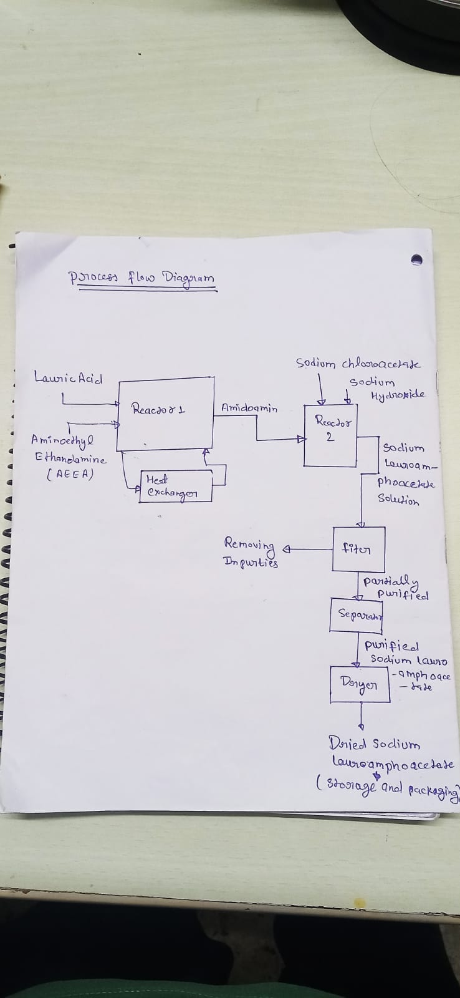
FLOWCHART
43

Slide 44



Environment Clearence
Sunny Kumar
Aman Singh
44

Slide 45
Sodium Lauroamphoacetate
Key Waste Generation and Regulatory Compliance
Waste Generated & Quantities
Impure Water:
53.95 kg/day (by-product of Amidation reaction).
NaCl (Sodium Chloride):
175.08 kg/day (by-product of Carboxymethylation reaction).
Lauric Acid & Sodium Monochloroacetate are recycled, not considered waste.
Regulatory Limits for Disposal
Impure Water (CPCB/EPA/REACH Compliance)
BOD ≤ 30 mg/L, COD ≤ 250 mg/L, TDS ≤ 2100 mg/L, pH 6.5–8.5, Oil & Grease ≤ 10 mg/L.
Treatment Steps:
Primary (Filtration/Sedimentation) → Secondary (Biological) → Tertiary (RO/Chemical Oxidation).
NaCl Disposal Guidelines
Non-hazardous but regulated:
TDS ≤ 2100 mg/L, Sodium ≤ 200 mg/L (water discharge).
Landfill: Secure sites to prevent groundwater contamination.
Reuse: Industrial applications (e.g., textiles).
45

Slide 46
Treatment Process and Safety Concerns
Zero Liquid Discharge (ZLD) Treatment
Block Diagram Summary:
Wastewater: Collection → Primary → Secondary → Tertiary → Reuse/Discharge.
NaCl Solution: Pre-Treatment → Evaporation → Crystallization → Reuse/Sale.
Water Recovery: Condensation → Recycled to process.
Safety & Exposure Limits (TWA/STEL)
Chemical | Hazards | TWA (8h) | STEL (15min)
AEEA | Skin burns, eye/respiratory damage | 2 ppm (ACGIH) | 4 ppm (ACGIH)
Sodium Monochloroacetate | Toxic, aquatic harm | 0.1 ppm (ACGIH) | 0.3 ppm (ACGIH)
Amidoamine | Skin/eye irritation | 0.1–1 mg/m³ | Not specified
46

Slide 47
Key Insights
ZLD Achievable: Full water reuse & NaCl recovery align with sustainability goals.
Strict Compliance Needed: BOD/COD/TDS limits critical for water disposal.
Safety First: AEEA and Sodium Monochloroacetate require strict exposure controls.
Parameter | Limit | Status
BOD | ≤30 mg/L | ✅ (Safe)
TDS | ≤2100 mg/L | ⚠️ (Monitor)
pH | 6.5–8.5 | ✅ (Safe)
Chemical | TWA | STEL | Hazard Symbol
AEEA | 2 ppm | 4 ppm | ☠️ (Toxic)
NaCl | Non-toxic | - | ♻️ (Recycle)
Regulatory Compliance Snapshot
Safety heatmap
47

Slide 48
Malathion Production (C₁₀H₁₉O₆PS₂)
Main Waste Streams:
Aqueous Waste: ~250–400 kg (neutralization salts, water byproducts)
Solvent Residues: ~50–75 kg (Toluene, Xylene, Hexane, DCM losses)
Solid Residues: ~20 kg unreacted materials, P₂S₅ sludge
Gaseous Waste: ~33 kg H₂S (after scrubbing)
Regulatory Limits (CPCB):
H₂S Gas: ≤5 mg/Nm³ (must scrub with NaOH)
Acidic/Basic Waste: pH 6.5–8.5, TDS ≤2,100 mg/L
Solvent Waste: VOC ≤150 mg/Nm³ (incinerate or recover)
Solid Waste: Reactive sulfides <1%, stabilized before landfill
Zero Liquid Discharge (ZLD) Treatment:
Gaseous Scrubbing → Na₂S formation
Neutralization → Controlled pH discharge
Solvent Recovery/Incineration
Solid Waste Stabilization → Secure Landfill
48

Slide 49
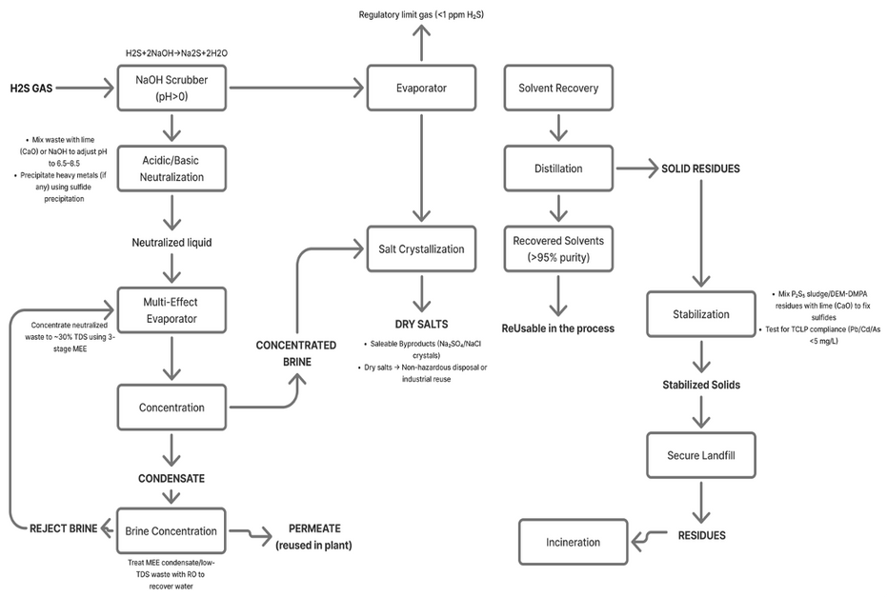
Key Chemical Safety & Exposure Limits:
Suggested ZLD Block Diagram:
Chemical | TWA (8 hr) | STEL (15 min) | Hazards
Malathion | 10 mg/m³ | 10 mg/m³ | Eye irritation, poisoning
P₂S₅ | 1 mg/m³ | 3 mg/m³ | Toxic gas release
H₂S | 1 ppm | 5 ppm | Toxic, flammable
H₂SO₄ | 1 mg/m³ | 3 mg/m³ | Corrosive burns
CH₃OH | 260 mg/m³ | 325 mg/m³ | Toxic, flammable
DCM | 25 ppm | 125 ppm | Carcinogenic vapors
49

Slide 50
Thank you
50

